Slide 1
Data Analyst Portfolio Project
By: Ilham Prawira Hasbi

Slide 2
About
This dataset contains Melbourne housing snapshot from 2016 to 2017.
The dataset was taken from Kaggle.
This is a snapshot of a dataset created by Tony Pino. It was scraped from publicly available results posted every week from Domain.com.au . The dataset includes Address, Type of Real estate, Suburb, Method of Selling, Rooms, Price, Real Estate Agent, Date of Sale and distance from C.B.D. (Central Business District).
Notes on Specific Variables
Rooms: Number of rooms
Price: Price in dollars
Method: S - property sold; SP - property sold prior; PI - property passed in; PN - sold prior not disclosed; SN - sold not disclosed; NB - no bid; VB - vendor bid; W - withdrawn prior to auction; SA - sold after auction; SS - sold after auction price not disclosed. N/A - price or highest bid not available.
Type: br - bedroom(s); h - house,cottage,villa, semi,terrace; u - unit, duplex; t - townhouse; dev site - development site; o res - other residential.
SellerG: Real Estate Agent

Slide 3
About
Date: Date sold
Distance: Distance from CBD
Regionname: General Region (West, North West, North, North east …etc)
Propertycount: Number of properties that exist in the suburb.
Bedroom2 : Scraped # of Bedrooms (from different source)
Bathroom: Number of Bathrooms
Car: Number of carspots
Landsize: Land Size
BuildingArea: Building Size
CouncilArea: Governing council for the area

Slide 4
Business Objective
Comparing real estate prices by region.
Determine which suburb has the cheapest prices of real estate.
Find out the average price of real estate and how far it is from the Central Business District (CBD).
Determine the impact of distance on real estate prices
Identify the relationship between real estate land size and price
Identify annual price trends by real estate type
Find out real estate type with many amenities, affordable prices and close to CBD
Discover real estate types with larger than average acreage at affordable prices.

Slide 5



TOOLS
Data Preparation
DBMS, Analysis
Dashboard visualization

Slide 6
Data Exploration

Slide 7
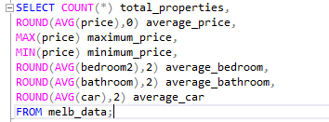
General Statistics
Query:
Total properties are 13.580 ; average property price is $1.075.684 ; highest property price is $9.000.000 ; lowest property price is $85.000 ; average number of bedrooms per property is 2,91 ; average number of bathrooms per property is 1,53 ; and average number of carspots per property is 1,61.

Slide 8
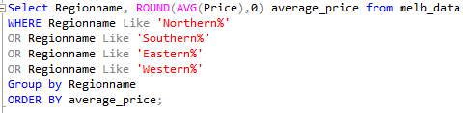
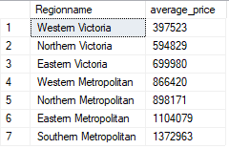
Real estate prices by region
Query:
The region with the cheapest property prices is Western Victoria and the most expensive property is in the Southern Metropolitan region.

Slide 9
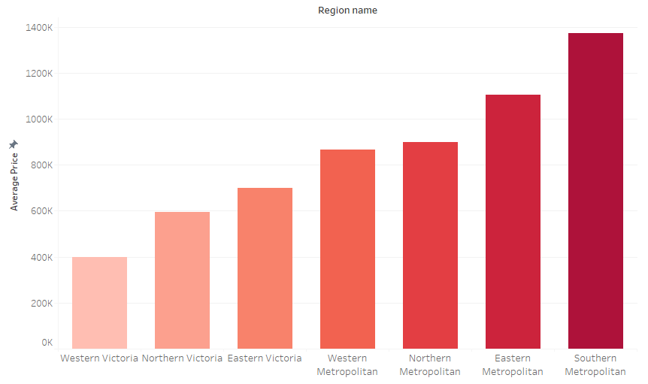
Real estate prices by region

Slide 10
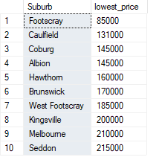
Suburb that has the cheapest prices of real estate
Query:
The cheapest suburb is Footscray at $85000.

Slide 11
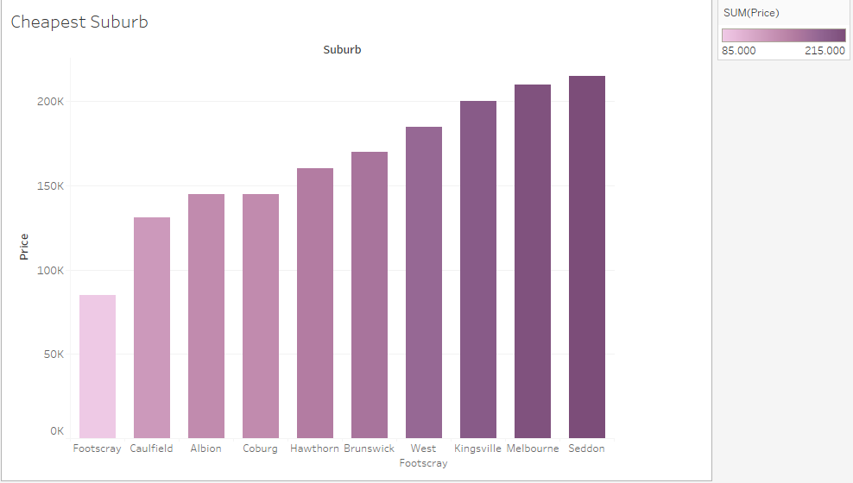
Suburb that has the cheapest prices of real estate

Slide 12
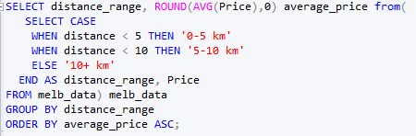

Average price of distance of Properties to CBD (Central Business District)
Query:
The average property price is not affected by the distance to the CBD. Properties 5-10 km away are more expensive than those 0-5 km away.

Slide 13
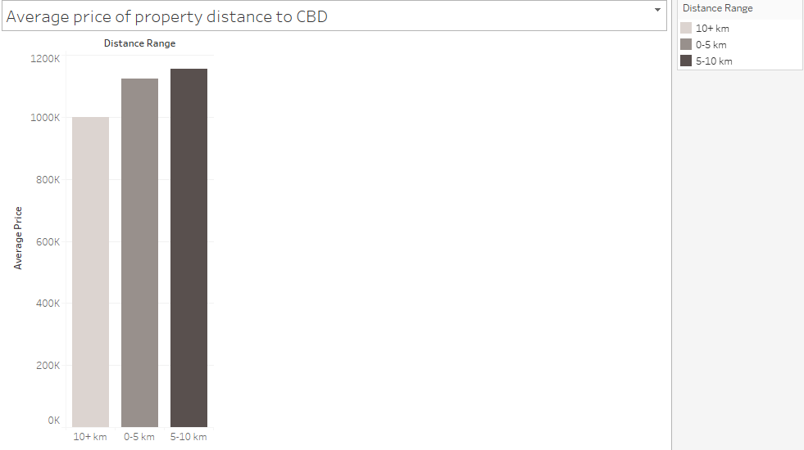
Average price of distance of Properties to CBD (Central Business District)

Slide 14
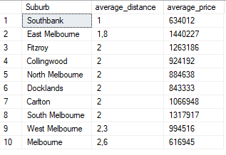
Impact of distance on real estate prices
Query:
The average price of a property in a suburb is not affected by its distance from the CBD. Prices in more distant Melbourne suburbs are cheaper than in East Melbourne, which is closer to the CBD.

Slide 15
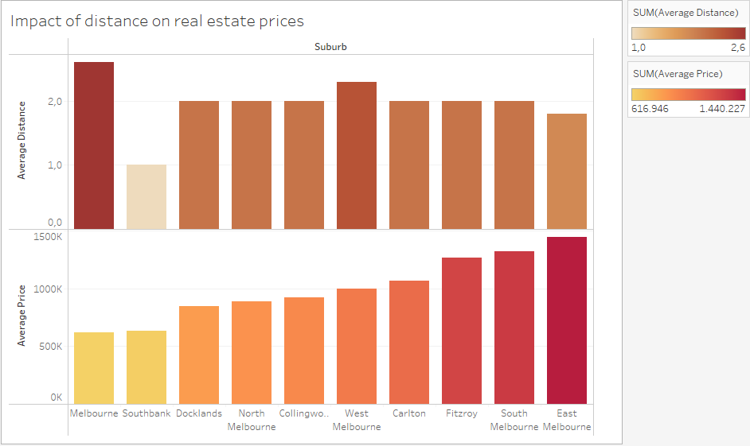
Impact of distance on real estate prices

Slide 16
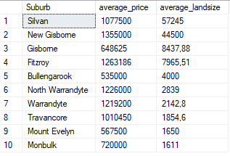
Relationship between real estate land size and price
Query:
The price of a property in the suburbs is not affected by the land size of the property. Prices in Monbulk suburb are more expensive than in Gisborne.

Slide 17
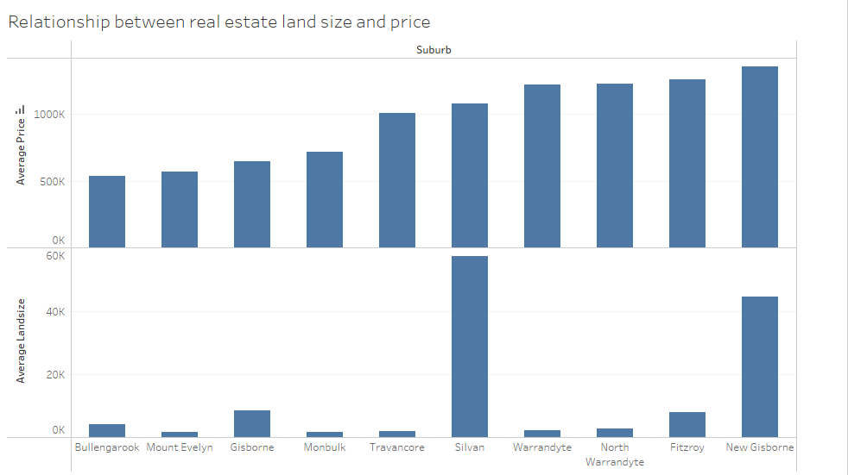
Relationship between real estate land size and price

Slide 18

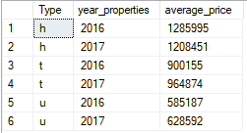
Annual price trends by real estate type
Query:
Prices for property types h (house, cottage, villa, semi, terrace) decreased from 2016 to 2017, while prices for property types t (townhouse) and u (unit, duplex) increased.

Slide 19
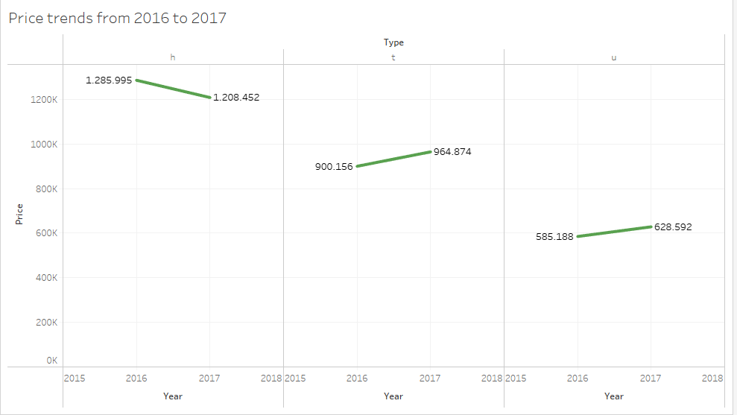
Annual price trends by real estate type

Slide 20
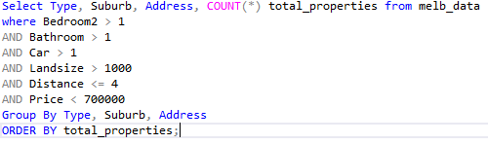

Real estate type with many amenities, affordable prices and close to CBD
Query:
Properties with many amenities such as more than 1 bedroom, more than 1 bathroom, land area of more than 1000, distance to CBD less than 4 and with affordable prices are found in Collingwood, Maribyrnong and Richmond suburbs with type U (unit, duplex).

Slide 21
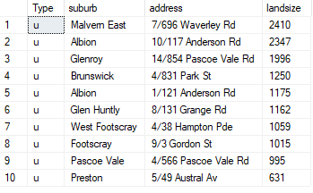

Real estate types with larger than average acreage at affordable prices.
Query:
Real estate with larger than average land size and affordable prices can be found in the suburb of Malvern East at 7/696 Waverley Rd.

Slide 22
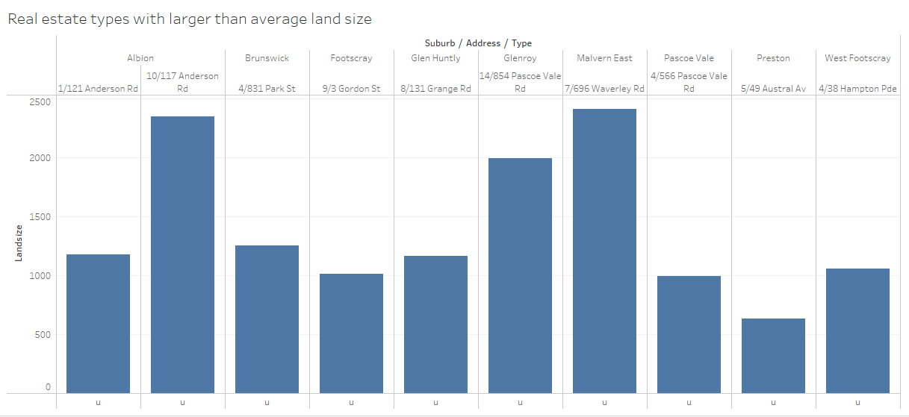
Real estate types with larger than average acreage at affordable prices.

Slide 23
Conclusions
The real estate distance factor to the CBD is not affected by price.
The land size factor of a real estate is not affected by price.
The determining factor of high and low real estate prices is the location, whether it's a suburb or a region.
Despite the price increase, the lowest priced property is the U type (unit, duplex).

